Slide 1
About JavaScript
David Tarvin, AIM Code School

Slide 2
What is JavaScript?
JavaScript is a scripting or programming language that allows one to implement complex features on web pages
displaying timely content updates
Interactive maps
Animated 2D/3D graphics
Scrolling video jukeboxes
Countless others

Slide 3
But what is it actually?
JavaScript is a lightweight, cross-platform, single-threaded, and interpreted or just-in-time compiled programming language well-known for the development of web pages, as well as its use in many non-browser environments

Slide 4
What does lightweight mean?
Lightweight programming languages are those which are designed:
To consume minimal memory resources when its code or an application is running
To ease the implementation across platforms such as web, mobile, desktop, etc.
To have a minimalist, simple syntax, semantics to help in learning quickly

Slide 5
How is JavaScript lightweight?
It makes applications consume fewer resources than other language implementations
It runs on browsers without any dependencies
New features are constantly added so users need not write any new code, making it leaner on resources
It has a minimal set of language constructs, which can be leveraged to handle any requirement for a given application
Learning the language does not require a great deal of effort

Slide 6
What makes JavaScript cross-platform?
Originally designed to run in the browser
Now used for such things as:
Native application development
Virtual reality
Building chat and voice-controlled bots
Games
Machine learning
Just about anything you can think up

Slide 7
What is a thread?
Threads are lightweight processes that run concurrently in a program
Each thread has a stack upon which is put tasks that need completed
Threads share resources such as memory, code, and data with other threads

Slide 8
What does multi-threaded mean?
Multithreading allows a program to perform several tasks simultaneously
Useful for running heavy computations or handling multiple requests in a web application
Multi-threaded languages include Java, C and C++, C#, Python and Rust

Slide 9
What does single-threaded mean?
A single-threaded is one that can execute only one task at a time
The program executes the tasks in sequence, and each task must complete before the next task starts
Long-running tasks can block the execution of other code
Can result in slow and unresponsive web pages

Slide 10
Why is JavaScript single-threaded?
When JavaScript was invented, its primary use was in the browser to add interactivity to web pages
Computers were slower with limited processing power
JavaScript was made single-threaded to keep the language simple and efficient

Slide 11
Ways around single-thread limitations
Asynchronous Programming Techniques
Uses callbacks, promises, and async/await
Allows us to perform long-running tasks without blocking the execution of other code
Web workers
A type of JavaScript thread that runs in the background
Allows execution of heavy computations or I/O operations without blocking the main thread
Results in a more responsive user interface

Slide 12
What is a compiled language?
A compiled language is a programming language that is converted from human-readable code into computer-readable machine code so that the computer’s CPU can execute it
Compiled languages include C, C++, COBOL

Slide 13
What is machine code?
Machine code (machine language) is the elemental language of computers
Called a low-level language because it is not readable by humans
Consists of binary or hexadecimal code read directly by the computer’s CPU
Allows direct control of the hardware of the computer

Slide 14
What is an interpreted language?
An interpreted language is one in which implementations perform instructions directly and easily without compiling a program into machine language instructions first
The language interpreter reads the source file line by line and converts and executes it immediately
Interpreted languages are high-level because they are generally readable by humans (in English)
Interpreted languages include Python, JavaScript, Perl

Slide 15
Compiled vs interpreted
Compiled languages:
Run faster than interpreted languages
Can be executed directly by the CPU
Deliver better performance
Give more control over hardware aspects, like memory management and CPU usage
Require recompilation every time code is edited
Are platform-dependent of the generated binary code

Slide 16
Compiled vs interpreted (cont’d)
Interpreted languages:
Generally slower, but changing with just-in-time compilation
More flexible
developers can make changes to the code on the fly
Language can adapt to runtime conditions in an automated way
Often offer features such as dynamic typing and smaller program size
Platform independent because interpreters execute the source code themselves

Slide 17
What is just-in-time compilation?
While the interpreted language is being run, the just-in-time compiler determines the most frequently used code and compiles it to machine code
Done just on sections of the entire code
Result - interpreter doesn’t have to interpret bytecode ever time a method is invoked
Done during the execution of the code as opposed to prior to execution
Because compilation takes place at runtime, the just-in-time compiler has access to dynamic runtime information which enables it to make better optimizations

Slide 18
Adding JavaScript to a web page
Two ways:
Adding it directly in HTML
Linking an external file to the web page

Slide 19
Adding JavaScript directly in HTML
Need <script> tags
<script> alert(“Hi there”); </script>
Can either be placed within the <head> tags or within the <body> tags
Best to put within the <body> tags as the last element in the body
Putting within the <head> tags can cause JavaScript to run before the body of the web page is completely created, which can cause problems, errors, or unexpected results.

Slide 20
Basic useful JavaScript methods
alert();
Causes a box to pop up on the screen with whatever message is put in the parentheses alert(“Hi there!”);
prompt();
Same as alert, but also includes an input box for the user to type something in that will be saved in a variable or otherwise used in the code somehow let age = prompt(“Please enter your age:”);

Slide 21
Basic useful JavaScript methods (cont’d)
console.log();
Prints into the browser console whatever is written within the method’s parentheses
To access the console, hit F12 on the computer or right-click on the web page and click “Inspect”, then click on Console at the top of the Developer’s Tools

Slide 22
References
What is JavaScript?, MDN Web Docs, https://developer.mozilla.org/en-US/docs/Learn/JavaScript/First_steps/What_is_JavaScript, accessed May 19, 2024.
Why JavaScript is called lightweight?, Subodh Kumar, JavaScript in Plain English, Jan 3, 2022, https://javascript.plainenglish.io/why-javascript-is-called-lightweight-5a1996db9ef6, accessed May 19, 2024.
Introduction to JavaScript, GeeksForGeeks, last updated Feb 2, 2024, https://www.geeksforgeeks.org/introduction-to-javascript/, accessed May 19, 2024.
Interpreted vs Compiled Programming Languages: What’s the Difference?, Free Code Camp, January 10, 2020, https://www.freecodecamp.org/news/compiled-versus-interpreted-languages/, accessed May 19, 2024
Why is JavaScript Single Threaded?, Matt Long, Grove Technology, July 21, 2023, https://groovetechnology.com/blog/why-javascript-is-single-threaded/#:~:text=JavaScript%20was%20designed%20to%20be,interactivity%20to%20static%20web%20pages., accessed May 19, 2024.

Slide 23
References (cont’d)
Just in Time Compilation Explained, Free Code Camp, Feb 1, 2020, https://www.freecodecamp.org/news/just-in-time-compilation-explained/, accessed May 19, 2024.

Slide 24
JavaScript {
[Bits, Values and Bindings]
< David Tarvin, AIM Code School >
}
Programming Language

Slide 25
Bits and Values

Slide 26
What is a value?
A value is a piece of information (data) that can be stored, retrieved, manipulated and used in the execution of a program

Slide 27
Values
Values
Chunks of bits that represent pieces of information
Stored in memory locations
Creating a value
Invoke its name

Slide 28
Bits
Bit - something that has two possible states/values
On or off
Zero or one
High charge or low charge
Strong or weak signal
Shiny or dull spot (CDs)
Binary - a base 2 numbering system
Count using only 0s and 1s

Slide 29
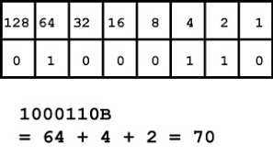
Binary
Binary - a base 2 numbering system
Count using only 0s and 1s

Slide 30
Bindings
Association of a name with a value
Also referred to as Named Binding
Purpose
To store values generated by expressions in your code
Allows you to reference those values in your code
Without bindings the program would not be able to remember the work it has already done

Slide 31
Binding - variables and constants
Variable - a type of binding that allows you to update the value associated with a particular name as needed
Constant - a type of binding where the value associated with a particular name cannot be changed
Notes:
Five different types of binding discussed here: https://medium.com/@sinalotfi.cs/javascript-named-binding-scope-and-closure-de48cc629f64

Slide 32
JavaScript {
[Data Types]
< David Tarvin, AIM Code School >
}
Programming Language

Slide 33
Two categories of data types
Primitive
Immutable
Copied by value
Non-Primitive
Mutable
Copied by reference

Slide 34
7 Primitive Data Types
string
boolean
Text/character values
true/false value
number
null
Numeric values
No value or empty value
BigInt
undefined
Values too large to be number data type
Not assigned a value
Symbol
For unique values

Slide 35
Non-primitive data types
Object
Includes Arrays, Functions and Regular Expressions

Slide 36
Data type string
Stores sequences of characters enclosed in single quotes (‘), double quotes (“) or backticks (`)
Problem with using single quotes - you can’t then use single quotes as an apostrophe without ‘escaping’ it
Will end string prematurely and cause error

Slide 37
Escape character (string)
Escaping a character is done using a backslash (\)
Used with special characters in a string so they are taken as the literal character rather than as a special character
Backslash also used with certain characters to do specific things with strings

Slide 38
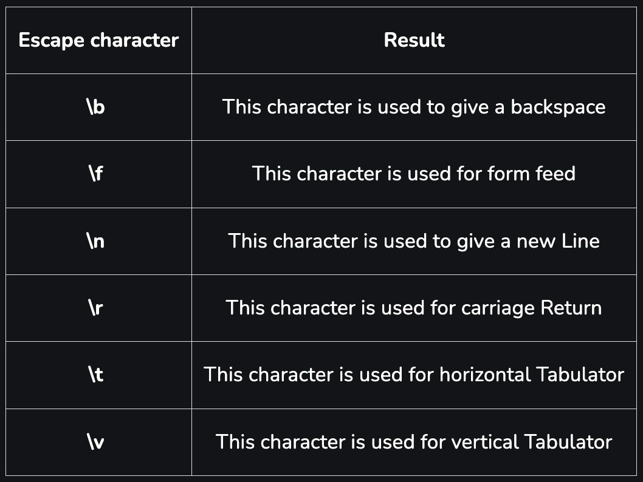
Escape character (string)

Slide 39
Newline character (string)
Break up code lines within strings with the newline character (\n)
let haiku = “Oh my aching back\n might as well claim workers comp\n it’s thrown out again”;

Slide 40
Concatenation (string)
Use plus sign (+) to put two or more strings together, along with variable or numbers to go with the strings
Hint - don’t forget spaces
// Concatenation let numOfStudents = 23; console.log(“There are “ + numOfStudents + “ students in my class.”); // There are 23 students in my class.

Slide 41
Template literals (string)
Done using backticks (`)
Allow you to put whole string together, including variables, instead of breaking string up and concatenating
Variables are included by putting variable in curly braces {} and prefixing the braces with a dollar sign ($)
// Template literal console.log(`There are ${numOfStudents} students in my class.`); // There are 23 students in my class.

Slide 42
Data type number
Handles any numerical value
Doesn’t differentiate between integers and floats (other languages do)
Integers - numbers without decimals (15, -12, 0)
Floats - numbers with decimals (42.05, -26.00007)

Slide 43
Data type number (cont’d)
Numbers are fixed as 64-bit values
Referred to as 64-bit floating point
Means they can represent 2^64 different numbers (18 quintillion - 18 zeros)
One bit has to represent sign (negative or positive)
Eleven bits have to store exponent
52 bits store the number (the fraction)

Slide 44
Underscores (number)
Long numbers are hard to read
8665481257
Underscores can make them easier to read without affecting the operation of the code
8_665_481_257

Slide 45
Scientific notation (number)
For extremely large or small numbers, use scientific notation
add an e for exponent followed by the exponent of the number
Ex: 2.998e8 = 2.998 * 10^8 = 299,800,000

Slide 46
Integer precision (number)
Highest integer that can be used in precise calculations is 2^53 - 1 (9,007,199,254,740,991 - approx 9 quadrillion)
Try this: let a = 9_007_199_254_740_991; let b = 100_000; console.log(a + b);
But: console.log(740_991 + 100_000);

Slide 47
Floating precision (number)
Floating point arithmetic is not always 100% accurate
console.log(0.2 + 0.1); // 0.30000000000000004
To solve the problem:
multiply the floating numbers by a common power of ten (10, 100, 1000) so they become integers
conduct the arithmetic
divide the result by the same power of 10 you multiplied with

Slide 48
Floating precision cont’d
let x = 0.2; let y = 0.1;
Step 1:
Multiply 0.2 * 10 and 0.3 * 10 // 2 + 1
Conduct arithmetic // 2 + 1 = 3
Divide result by 10 // 3/10 = 0.3
(0.2 + 0.1) is the same as (0.2*10 + 0.1*10)/10

Slide 49
Infinity, -Infinity (number)
Highest number in JavaScript:
1.797693134862315e+308
Any number higher than that is referred to as Infinity
Lowest number in JavaScript:
1.797693134862316e+308
Any number higher than that is referred to as -Infinity

Slide 50
Adding numbers and strings (number)
Adding two numbers results in a number
console.log(10 + 20); // 30
Adding two strings results in concatenation
A number surrounded by quotes is a numeric string
console.log(“10” + “20”); // 1020

Slide 51
Adding numbers and strings (number)
Adding a number and a numeric string results in concatenation
console.log(10 + “20”); // 1020
console.log(“10” + 20); // 1020

Slide 52
Adding numbers and strings (number)
let x = 45; let y = 25;
Let z = “15”;
What is the result here?
console.log(“The result is: “ + x + y);
What is the result here?
console.log(“The result is: “ + (x + y));

Slide 53
Adding numbers and strings (number)
let x = 45; let y = 25;
Let z = “15”;
What is the result here?
console.log(x + y + z);
What is the result here?
console.log(x + (y + z);

Slide 54
Data type BigInt
BigInt - a numerical data type representing both small and large numbers that cannot be represented by the data type number
Must contain a lowercase n after the number, e.g. 426n

Slide 55
Data type BigInt
Two ways to create:
Append n to a whole number
const bigIntOne = 135n;
Call BigInt() on a whole numerical value or a string with only an integer value
const bigIntTwo = BigInt(964);
Bad practice - could already have precision loss
const bigIntThree = BigInt(“857”);

Slide 56
Boolean

Slide 57
Symbol

Slide 58
undefined

Slide 59
null

Slide 60

Non-Primitive Data Types
David Tarvin, AIM Code School

Slide 61
Immutability
Means value cannot be changed once assigned
Can assign new value but cannot change old value
Ex: if assigning a string value to a variable, we could assign a new value to the variable, but we could not change a character in the old value
var word = “cat”; console.log(word[0]); // c word[0] = “r”; // no error shows console.log(word[0]); // c console.log(word); // cat

Slide 62
Copying by value vs by reference
All variable values are stored in memory at specific addresses
Copying of a variable is done with the “=” assignment operator

Slide 63
Copying by value vs by reference
Copying by value (primitive data type):
Variable holds the value directly
Variable doesn’t know the memory address of the value
Even if two variables have the same value for the same primitive data type, those values are stored at different memory locations
Copying by Reference (non-primitive data type):
Variable holds the memory address of the value, not the value directly

Slide 64
Copying by value
Means the new variable holds a copy of the old variable
The variables hold the same value but at different memory locations
Changing one does not affect the other
var a = 1; var b = a; a = 3; console.log(a); // 3 console.log(b); // 1

Slide 65
Copy by reference
Means the new variable holds a copy of the old variable’s reference to the value
Both variables hold not the value itself but the memory address for the value
Changing the value for one changes the value for the other
var a = [8, 3];
var b = a;
a.push(5);
console.log(a); // [8, 3, 5]
console.log(b); // [8, 3, 5]

Slide 66
Contents Of ‘This Template’;
forbeginners.html
workshop.css
Here’s what you’ll find in this Slidesgo template:
A slide structure based on a Workshop presentation, which you can easily adapt to your needs. For more info on how to edit the template, please visit Slidesgo School or read our FAQs.
An assortment of graphic resources that are suitable for use in the presentation can be found in the alternative resources slide.
A thanks slide, which you must keep so that proper credits for our design are given.
A resources slide, where you’ll find links to all the elements used in the template.
Instructions for use.
Final slides with:
The fonts and colors used in the template.
A selection of illustrations. You can also customize and animate them as you wish with the online editor. Visit Storyset to find more.
More infographic resources, whose size and color can be edited.
Sets of customizable icons of the following themes: general, business, avatar, creative process, education, help & support, medical, nature, performing arts, SEO & marketing, and teamwork.
You can delete this slide when you’re done editing the presentation.
Programming Language

Slide 67
Table Of ‘Contents’ {
01
02
03
forbeginners.html
workshop.css
Theory Lesson
< You can enter a subtitle here if you need it >
Features of the Topic
< You can enter a subtitle here if you need it >
Practical Exercise
< You can enter a subtitle here if you need it >
}
Programming Language

Slide 68
01 {
[Theory Lesson]
forbeginners.html
workshop.css
< You can enter a subtitle here if you need it >
}
Programming Language

Slide 69
Concepts < /1 > {
forbeginners.html
workshop.css
< Mercury is the closest planet to the Sun and the smallest one in the Solar System—it’s only a bit larger than the Moon >
}
Concepts < /2 > {
< Venus has a beautiful name and is the second planet from the Sun. It’s hot and has a poisonous atmosphere >
}
Programming Language

Slide 70
Introduction; {
forbeginners.html
workshop.css
‘Here you can give a brief description of the topic you want to talk about’
<p For example, if you want to talk about Mercury, you can say that it’s the smallest planet in the entire Solar System >
</p>
}
Programming Language

Slide 71
What Is this ‘Topic About ?’ {
forbeginners.html
workshop.css
Languages
Html
60%
Css
40%
< Mercury is the smallest planet in the entire Solar System >
< The Earth is the only one that harbors life in the Solar System >
Create a web page
Venus has a nice name
Mars is a cold place
Jupiter is a gas giant
}
Programming Language

Slide 72
Features of ‘the Topic’ {
forbeginners.html
workshop.css
Step 01
Mercury is the closest planet to the Sun and the smallest one
Step 02
Saturn is a gas giant and has several rings
Step 03
The Earth is the only planet that harbors life
Step 04
Venus has a beautiful name and is the second planet from the Sun
}
Programming Language

Slide 73
Recommendations; {
forbeginners.html
workshop.css
Mercury
< Mercury is the closest planet to the Sun and the smallest one in the Solar System >
Saturn
< It was named after the Roman god of wealth and agriculture >
Jupiter
< Jupiter is a gas giant and the biggest planet in the Solar System >
}
Programming Language

Slide 74
Examples About ‘The Topic’{
forbeginners.html
workshop.css
Mercury
Jupiter
< Mercury is the closest planet to the Sun >
< Jupiter is a gas giant and the biggest planet >
Saturn
Venus
< Saturn is a gas giant and has several rings >
< Venus has a nice name and high temperatures >
}
Programming Language

Slide 75
Practical Exercise {
< /1 >
< /2 >
forbeginners.html
workshop.css
< Saturn is the fourth-largest object by diameter in the Solar System >
Mercury is the smallest planet
The Earth is the planet we live on
Saturn is made of oxygen and helium
Jupiter is a gas giant
Venus has high temperatures
Neptune is very far away from the Sun
}
Programming Language

Slide 76
9h 55m 23s {
333,000.000
386,000 km
forbeginners.html
workshop.css
< Is Jupiter's rotation period >
< Earths fit in the Sun’s mass >
< Distance between the Moon and the Earth >
}
Programming Language

Slide 77

A ‘Picture’ Is { Worth a Thousand Words
}

Slide 78
Awesome { Words;
forbeginners.html
workshop.css
}
Programming Language

Slide 79
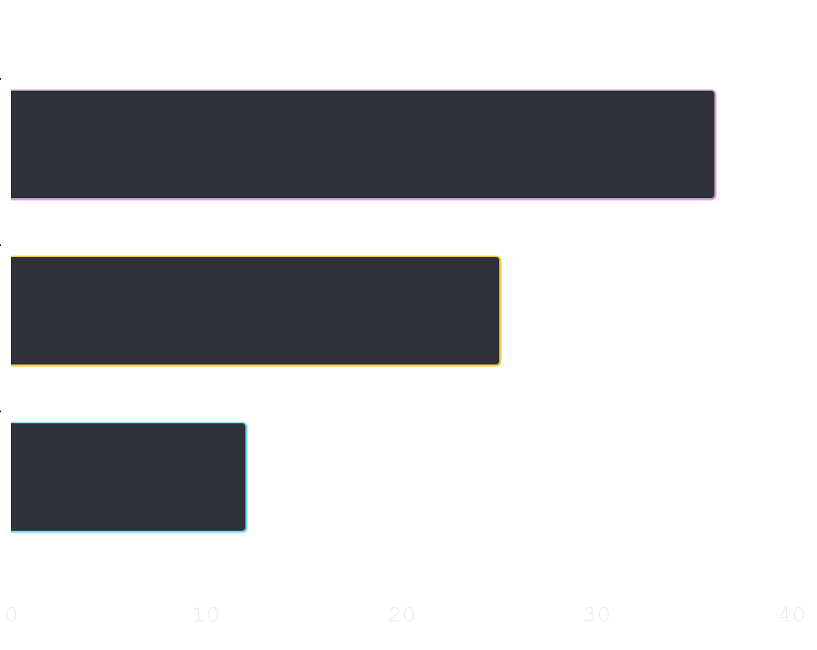
Did You Know ‘This ?’ {
forbeginners.html
workshop.css
36.00
Mercury is the smallest planet of the Solar System
25.00
Venus has a beautiful name and high temperatures
12.00
Despite being red, Mars is actually a cold place
}
Follow the link in the graph to modify its data and then paste the new one here. For more info, click here
Programming Language

Slide 80

A ‘Picture’ Always Reinforces The Concept {
forbeginners.html
workshop.css
< Images reveal large amounts of data, so remember: use an image instead of a long text. Your audience will appreciate it >
}
Programming Language

Slide 81
150,005,630 {
forbeginners.html
workshop.css
< Big numbers catch your audience’s attention >
}
Programming Language

Slide 82
— Someone ‘Famous’
forbeginners.html
workshop.css
< “This is a quote, words full of wisdom that someone important said and can make the reader get inspired.” >
Programming Language

Slide 83
Review ‘Concepts’ {
forbeginners.html
workshop.css
< Mercury is the closest planet to the Sun and the smallest one in the Solar System >
Venus
Ceres
Saturn
}
Programming Language

Slide 84
Planning of ‘September’{
forbeginners.html
workshop.css
M | T | W | T | F | S | S
 |  | 01 | 02 | 03 | 04 | 05
06 | 07 | 08 | 09 | 10 | 11 | 12
13 | 14 | 15 | 16 | 17 | 18 | 19
20 | 21 | 22 | 23 | 24 | 25 | 26
27 | 28 | 29 | 30
Mercury is the smallest planet
Venus has a beautiful name
The Earth is the third planet
Mars is actually a cold place
Jupiter is a gas giant
}
Programming Language

Slide 85
JavaScript For ‘Beginners’ {
forbeginners.html
workshop.css
Mercury
Mars
It is the closest planet to the Sun
Despite being red, Mars is a cold place
Jupiter
Venus
Jupiter is the biggest planet
Venus is the second planet from the Sun
Saturn
Neptune
Saturn is a gas giant and has several rings
Neptune is very far from the Earth
}
Programming Language

Slide 86
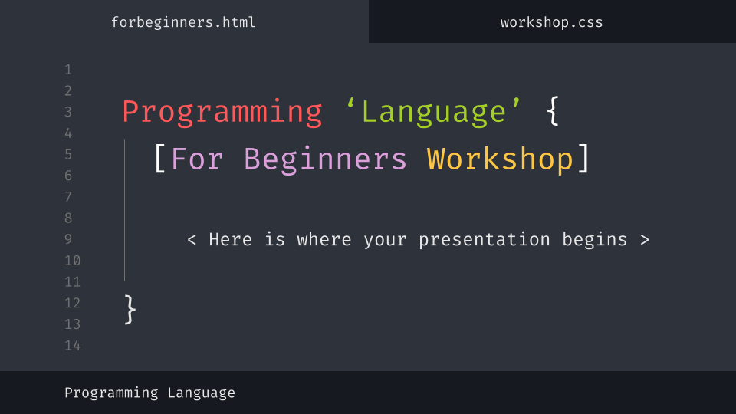
Desktop Software {
forbeginners.html
workshop.css
You can replace the image on the screen with your own work. Just delete this one, add yours and center it properly
}
Programming Language

Slide 87
Thanks; {
forbeginners.html
workshop.css
‘Do you have any questions?’
youremail@freepik.com
+91 620 421 838
yourcompany.com
< Please keep this slide for attribution >
}
Programming Language

Slide 88
Web ‘Design’
forbeginners.html
workshop.css
Programming Language

Slide 89
Alternative ‘Resources’ {
forbeginners.html
workshop.css
Here’s an assortment of alternative resources whose style fits the one of this template
Photos:
Portrait hacker I
Portrait hacker II
}
Programming Language

Slide 90
Resources {
forbeginners.html
workshop.css
Did you like the resources on this template? Get them for free at our other websites:
Photos:
Close up hacker
Medium shot woman working computer
Icons:
Web design
}
Programming Language

Slide 91
Instructions for use
In order to use this template, you must credit Slidesgo by keeping the Thanks slide.
You are allowed to:
- Modify this template.
- Use it for both personal and commercial projects.
You are not allowed to:
- Sublicense, sell or rent any of Slidesgo Content (or a modified version of Slidesgo Content).
- Distribute Slidesgo Content unless it has been expressly authorized by Slidesgo.
- Include Slidesgo Content in an online or offline database or file.
- Offer Slidesgo templates (or modified versions of Slidesgo templates) for download.
- Acquire the copyright of Slidesgo Content.
For more information about editing slides, please read our FAQs or visit Slidesgo School:
https://slidesgo.com/faqs and https://slidesgo.com/slidesgo-school

Slide 92
Instructions for use (premium users)
As a Premium user, you can use this template without attributing Slidesgo or keeping the "Thanks" slide.
You are allowed to:
Modify this template.
Use it for both personal and commercial purposes.
Hide or delete the “Thanks” slide and the mention to Slidesgo in the credits.
Share this template in an editable format with people who are not part of your team.
You are not allowed to:
Sublicense, sell or rent this Slidesgo Template (or a modified version of this Slidesgo Template).
Distribute this Slidesgo Template (or a modified version of this Slidesgo Template) or include it in a database or in any other product or service that offers downloadable images, icons or presentations that may be subject to distribution or resale.
Use any of the elements that are part of this Slidesgo Template in an isolated and separated way from this Template.
Register any of the elements that are part of this template as a trademark or logo, or register it as a work in an intellectual property registry or similar.
For more information about editing slides, please read our FAQs or visit Slidesgo School:
https://slidesgo.com/faqs and https://slidesgo.com/slidesgo-school

Slide 93
Fonts & colors used
This presentation has been made using the following fonts:
Fira Code
(https://fonts.google.com/specimen/Fira+Code)
#16191f
#2e323b
#707070
#e7e7e7
#ffffff
#ff5858
#fcc642
#dba0db
#72d9f0
#a5cf27

Slide 94
Storyset
Create your Story with our illustrated concepts. Choose the style you like the most, edit its colors, pick the background and layers you want to show and bring them to life with the animator panel! It will boost your presentation. Check out How it Works.
Pana
Amico
Bro
Rafiki
Cuate

Slide 95
Use our editable graphic resources...
You can easily resize these resources without losing quality. To change the color, just ungroup the resource and click on the object you want to change. Then, click on the paint bucket and select the color you want. Group the resource again when you’re done. You can also look for more infographics on Slidesgo.

Slide 98
JANUARY
FEBRUARY
MARCH
APRIL
MAY
JUNE
PHASE 1
Task 1
Task 2
PHASE 2
Task 1
Task 2
JANUARY
FEBRUARY
MARCH
APRIL
PHASE 1
Task 1
Task 2

Slide 101
...and our sets of editable icons
You can resize these icons without losing quality.
You can change the stroke and fill color; just select the icon and click on the paint bucket/pen.
In Google Slides, you can also use Flaticon’s extension, allowing you to customize and add even more icons.

Slide 102
Educational Icons
Medical Icons

Slide 103
Business Icons
Teamwork Icons

Slide 104
Help & Support Icons
Avatar Icons

Slide 105
Creative Process Icons
Performing Arts Icons

Slide 106
Nature Icons

Slide 107
SEO & Marketing Icons

Slide 108


